Slide 1

Structures, Unions, and Typedef in C
C offers ways to organize data effectively. Structures, unions, enums, and typedefs are key. They allow grouping different data types. This enhances data management and code readability.

Slide 2
Structure Definition
Grouping Data
Using Struct Keyword
Structures group different data types. They are placed under one name. This provides organized data management.
Structures are defined using the struct keyword. It is a fundamental part of structure declaration.

Slide 3
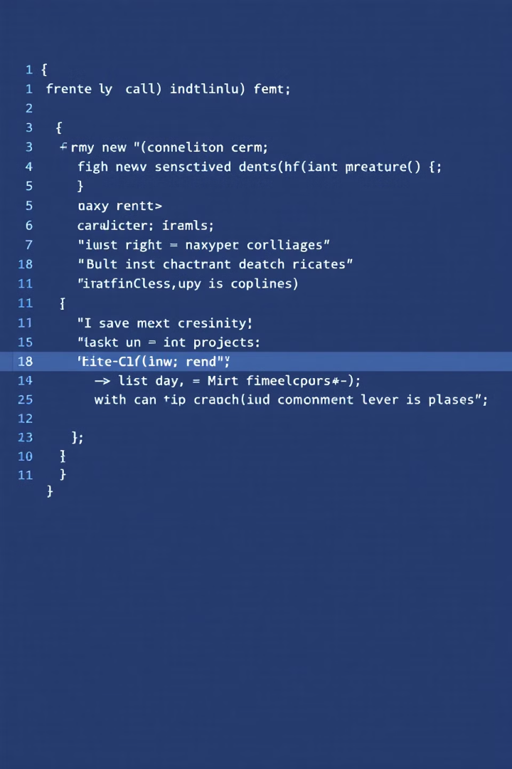


Structure Syntax
struct StructureName { dataType member1; dataType member2; // more members };
struct StructureName
This declares the structure's name.
dataType member1;
This declares members within the structure.

Slide 4
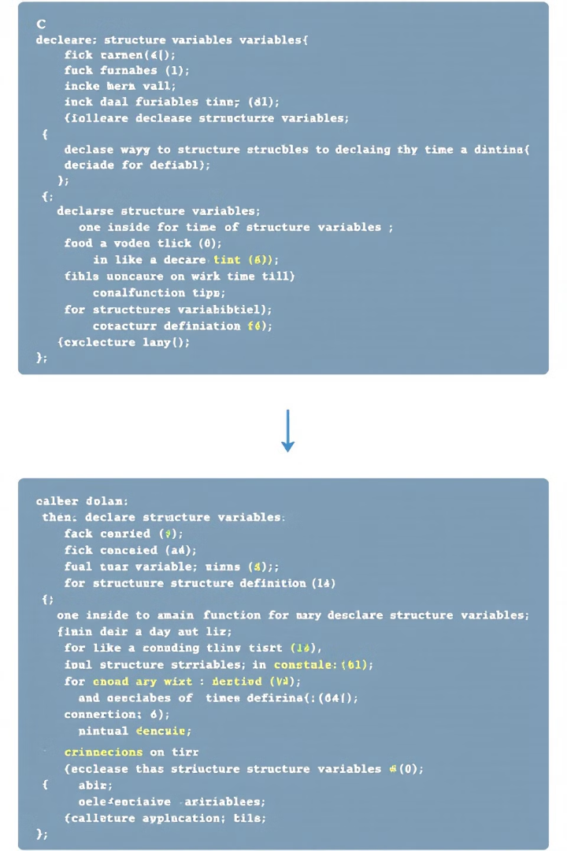
Declaring Structure Variables
Within main()
Declare inside the main function.
At Definition
Declare at the structure definition.

Slide 5


Structure Declaration Example
struct Student { char name[50]; int age; float marks; } s1, s2; int main() { struct Student s3; }
s1, s2
1
Global
s3
2
Local

Slide 6
Initializing Structures
At Declaration
Later
Initialize at the time of declaration. Provide values within curly braces.
Initialize later using assignment. Each member assigned separately.

Slide 7
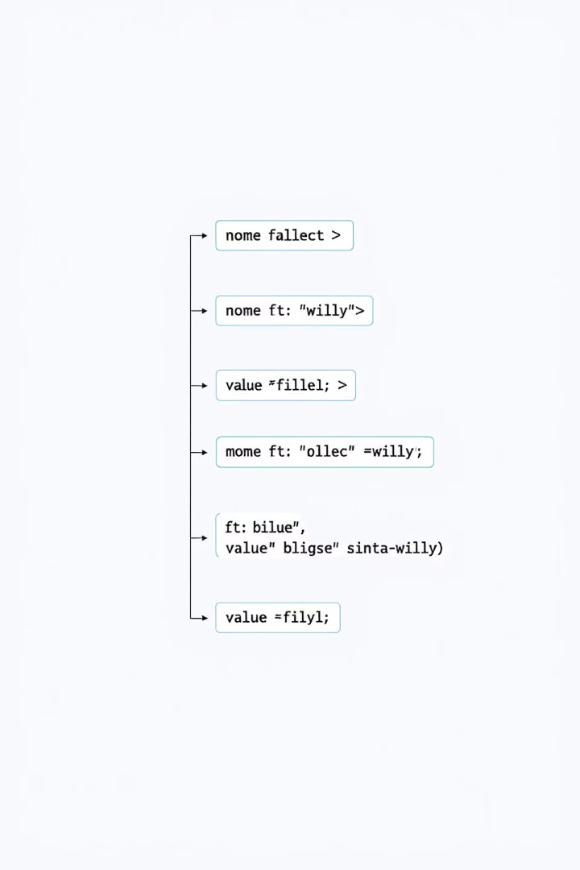
Initialization Example
struct Student s1 = {"John Doe", 20, 85.5};
1
"John Doe"
Name
2
20
Age
3
85.5
Marks

Slide 8
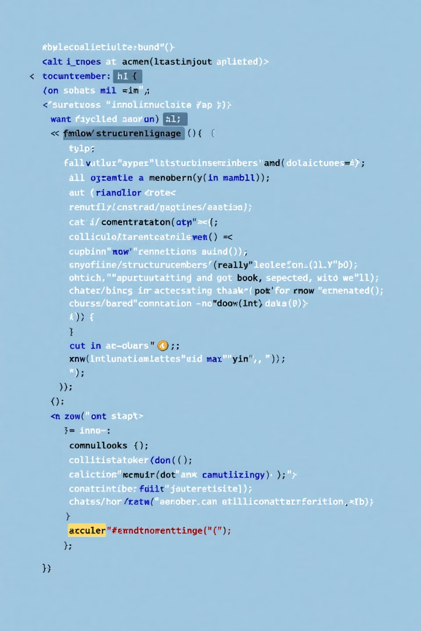
Accessing Structure Members
1
Dot Operator
Use the dot (.) operator. This accesses members of the structure.
2
Example
struct Student s1; s1.age = 20; printf("Age: %d", s1.age);

Slide 9
Arrays vs Structures: Key Differences
Arrays
Structures
Collection of homogeneous (same type) data elements
Collection of heterogeneous (different types) data elements
Elements accessed using index numbers (e.g., arr[0])
Elements accessed using dot (.) operator
Allocates static memory
Allocates dynamic memory
Elements must be of the same data type
Elements can be of different data types

Slide 10
Nested Structures in C
A nested structure occurs when one structure contains another structure as a member. This allows for more complex data organization.
1. Separate Structure
2. Embedded Structure
Define two independent structures, then use one inside another.
Define a structure directly within another structure.
struct Address {
char street[50];
char city[30];
};
struct Student {
char name[50];
struct Address addr; // nested structure
};
struct Student {
char name[50];
struct { // embedded structure
char street[50];
char city[30];
} addr;
};
Both approaches achieve the same result but offer different levels of reusability. Separate structures provide better reusability, while embedded structures keep related data more tightly coupled.

Slide 11
Accessing Nested Structures
Syntax Pattern
Example
To access members of a nested structure, use multiple dot operators chained together:
struct Date {
int dd;
int mm;
int yyyy;
};
struct Employee {
int id;
struct Date doj;
} e1;
// Accessing members
e1.doj.dd = 15; // day
e1.doj.mm = 8; // month
e1.doj.yyyy = 2023; // year
outer_variable.inner_structure.member
Each dot operator (.) accesses the next level deeper
Read from left to right: start with outermost structure

Slide 12
Arrays of Structures
What is an Array of Structures?
Example
An array of structures is a collection of multiple structure variables, where each array element contains a complete structure. It combines the features of arrays and structures to store multiple records of the same structure type.
struct Student {
char name[50];
int roll_no;
float marks;
};
// Array of 5 students
struct Student students[5];
// Accessing elements
students[0].roll_no = 1;
students[0].marks = 85.5;
Common uses include:
Student records in a class
Employee data in a company
Book information in a library

Slide 13
Passing Structures to Functions
Pass by Value
Pass by Reference
Global Structure
Creates a complete copy of structure. Original structure remains unchanged.
Passes structure address. Allows modification of original structure.
Structure accessible everywhere. No passing needed.
void func(struct Student s) {
s.marks = 90; // Changes copy
/* Original unchanged */
}
void func(struct Student *s) {
s->marks = 90; // Changes original
/* Modifies original */
}
struct Student s; // Global
void func() {
s.marks = 90; // Direct access
/* Global access */
}
Each method has its trade-offs: pass-by-value is safe but inefficient for large structures, pass-by-reference is efficient but can modify original data, and global structures provide easy access but may create maintenance issues.

Slide 14
Passing Structures by Value
When a structure is passed by value to a function, a complete copy of the structure is created. Any modifications made inside the function affect only the copy, leaving the original structure unchanged.
struct Student {
char name[50];
int roll_no;
float marks;
};
void updateMarks(struct Student s) {
s.marks = 95.5; // Changes only the local copy
printf("Inside function: %.1f\n", s.marks); // 95.5
}
int main() {
struct Student student1 = {"John", 101, 85.5};
updateMarks(student1);
printf("Original marks: %.1f\n", student1.marks); // 85.5
}
In this example, even though we modify the marks inside the function, the original structure remains unaffected because we're working with a copy.

Slide 15
Passing Structures by Reference
When passing a structure by reference, we pass the memory address of the structure using pointers. This allows functions to modify the original structure and is more memory efficient than passing by value.
struct Student {
char name[50];
int roll_no;
float marks;
};
void updateStudent(struct Student *s) {
s->marks = 95.5; // Modifies original
strcpy(s->name, "Bob"); // Changes original name
}
int main() {
struct Student student1 = {"Alice", 101, 85.5};
updateStudent(&student1); // Pass address
printf("Updated marks: %.1f\n", student1.marks); // 95.5
printf("New name: %s\n", student1.name); // Bob
}
Notice the use of the arrow operator (->) to access structure members through a pointer, and how changes made in the function affect the original structure.

Slide 16
Passing Structures: Global Approach
Global Structure Access
// Global structure declaration
struct Student {
char name[50];
int roll_no;
float marks;
} student; // Global variable
void updateMarks() {
student.marks = 95.5; // Direct access
}
void displayInfo() {
printf("%s: %.1f\n",
student.name,
student.marks);
}
Global structures are accessible throughout the program without explicitly passing them to functions. While this provides easy access, it can lead to maintainability issues and is generally not recommended for large programs.
Key considerations:
Accessible from any function
No parameter passing required
Can be modified by any function

Slide 17
Returning Structures
Functions can return entire structures, though returning pointers to structures is more common for better performance.
struct Student getStudent() {
struct Student s;
return s;
}

Slide 18
Self-Referential Structures
What is a Self-Referential Structure?
Example Implementation
A self-referential structure is a structure that contains at least one member pointer that points to a structure of the same type. This creates a recursive pattern that allows structures to reference themselves.
struct Node {
int data; // Data element
struct Node* next; // Pointer to same structure
};
// Creates a self-referential
// relationship where each Node
// can point to another Node
Common applications include:
Linked Lists
Binary Trees
Graph Nodes

Slide 19
Pointer to Structure in C
Declaration
Allocation
Access
Declaring a pointer involves using the * operator before the structure name.
Dynamically allocate memory using malloc() to store the structure.
Access structure members using the arrow operator (->).
Example: ptr->id = 42;
For example: struct Data *ptr;
Example: ptr = (struct Data*) malloc(sizeof(struct Data));

Slide 20
Pointer to Structure in C Example
Code:
Explanation:
#include struct Student { int id; float marks; }; int main() { struct Student s1 = {101, 85.5}; struct Student *ptr = &s1; printf("ID: %d\n", ptr->id); printf("Marks: %.2f\n", ptr->marks); ptr->marks = 90.5; printf("Updated Marks: %.2f\n", ptr->marks); return 0; }
A struct named Student is declared. It contains an integer ID and a float for marks.
A pointer to the structure is created. We use this pointer to change data in the structure.

Slide 21
Unions in C
A union is a special data type in C that allows storing different data types in the same memory location. Unlike structures, unions use a single shared memory space for all their members, with the size determined by the largest member.
union Data {
int i; // 4 bytes
float f; // 4 bytes
char str[8]; // 8 bytes
} data;
In this example, the union Data will occupy 8 bytes of memory (size of largest member), regardless of which member is being used. Only one member can hold a value at a time - when you assign a new value to any member, it overwrites the memory of other members.
Key Characteristics:
All members share the same memory space
Size equals the largest member's size
Only one member can be used at a time
Commonly used in embedded systems and device drivers

Slide 22
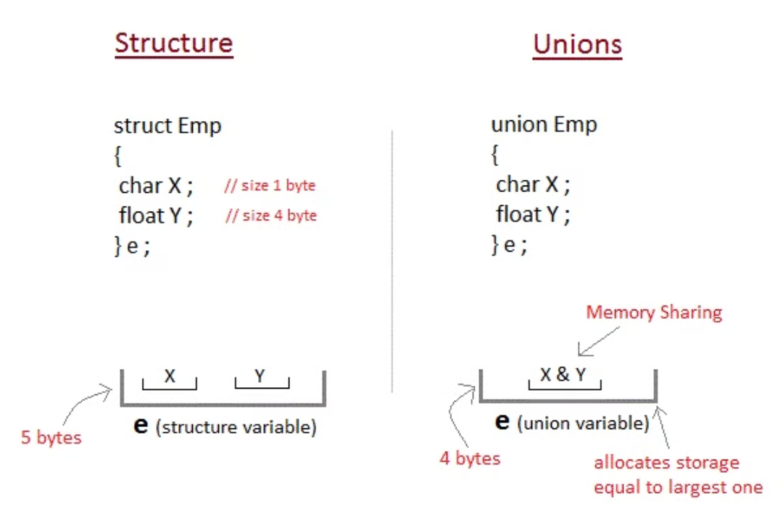
Structure vs Union: Memory Allocation

Slide 23
Union Syntax
A union definition specifies its structure and members:
union union_name {
data_type member1;
data_type member2;
/* ... */
data_type memberN;
};
Remember that all members share the same memory space, and only one member can hold a value at a time.

Slide 24
Union Example in C
Key Points
union Data {
int id; // 4 bytes
double price; // 8 bytes
char name[20]; // 20 bytes
} item;
// Using the union
int main() {
item.id = 42;
printf("ID: %d\n", item.id);
item.price = 17.99;
printf("Price: %.2f\n", item.price);
strcpy(item.name, "Product");
printf("Name: %s\n", item.name);
}
This union occupies 20 bytes (size of largest member)
Only one member can store value at a time
Accessing a different member than the last assigned will yield undefined behavior
Perfect for saving memory when variables are mutually exclusive

Slide 25
Difference between Structure and Union
Structure
Union
Use struct keyword.
Use union keyword.
Occupies more memory.
Occupies less memory.
Access all members at once.
Access one member at a time.
Separate storage for each member.
Common storage for all members.

Slide 26
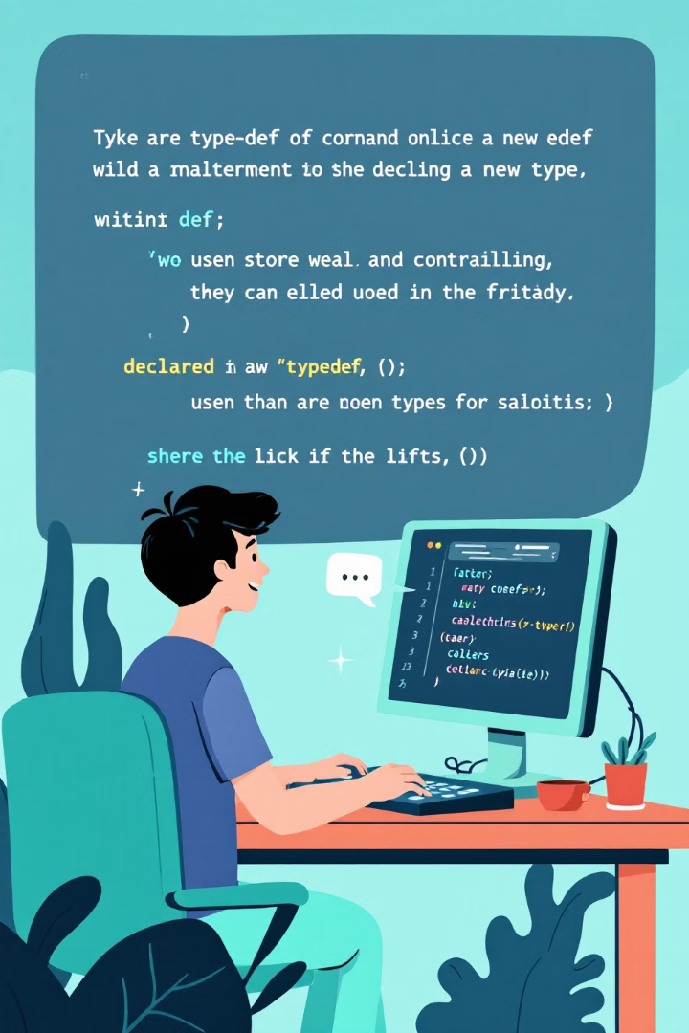
typedef
The typedef keyword creates new names for existing data types.
It redefines the name of a variable type.
This enhances code readability and maintainability.
It can also simplify complex declarations.

Slide 27
typedef Syntax
Basic Syntax
// Basic typedef examples
typedef unsigned long ulong;
// Structure typedef
typedef struct {
int x, y;
} Point;
// Usage
ulong number = 1000000L;
Point p = {10, 20};
typedef existing_type new_name;
Common Uses
Create aliases for complex data types, structs, and pointers
Benefits
Improves code readability and maintainability
The typedef keyword creates aliases that make complex declarations more readable. Once defined, the new type name can be used just like built-in types.

Slide 28
typedef Example Use Cases
1
Shorter Type Names
2
Improved Readability
3
Abstraction
Use typedef to create short, descriptive names for complex types.
Aliases enhance code clarity and reduce verbosity in declarations.
Abstract underlying types, simplifying maintenance and future changes.
Example:
Example:
Example:
typedef unsigned long int uli;
uli num = 100000; // Instead of "unsigned long int num"
typedef struct Point {
int x;
int y;
} Point;
Point p1; // Instead of "struct Point p1"
typedef float Currency; // Can be changed to double later
Currency balance = 100.50; // Code using Currency stays the same

Slide 29
typedef with Pointers
Creating Pointer Aliases
Example
typedef can create meaningful aliases for pointer types, making complex pointer declarations more readable.
// Simple pointer typedef
typedef int* IntPtr;
IntPtr p = &value;
Common use cases include:
Function pointer types
These aliases make pointer declarations clearer and easier to understand.
Complex data structure pointers
Array pointers

